Slide 1

Seasonal Agriculture Performance Analysis
DHANALAKSHMI K –Solamalai college of engineering AICTE student ID: STU6a6b16a6214451785403046

Slide 2

PROBLEM STATEMENT
(Agricultural activities are influenced by seasonal variations in environmental conditions, farming practices, resource availability and market conditions. As a result, agricultural performance may differ from one season to another. However, raw agricultural data does not clearly explain how agricultural performance changes across seasons or what patterns can be observed in different seasonal conditions. The problem is to analyze the given agricultural dataset and investigate seasonal differences in agricultural performance by identifying meaningful patterns, trends, relationships and variations within the available data.

Slide 3
Project Description
A Python-based data analysis tool that processes a seasonal agriculture dataset
(4,000 farm records, 28 attributes across 8 states, 8 crops, 3 seasons) to study seasonal performance trends. It performs data cleaning (missing-value imputation, outlier checks) and feature engineering (cost/profit per hectare, profit margin), generates statistical tests (ANOVA) and 10+ visualizations covering yield, profitability, resource usage, irrigation methods, and correlations between environmental conditions and outcomes.

Slide 4

WHO ARE THE END USERS?
Farmers deciding which crops or irrigation methods suit each season
Agricultural planners and policymakers allocating seasonal resources
Students and analysts learning exploratory data analysis (EDA) on real-world agri data

Slide 5

Technology Used
  Python 3
  pandas, NumPy — data cleaning & analysis
  Matplotlib, Seaborn — visualizations
  SciPy — statistical testing (ANOVA)
  Google Colab / VS Code — development environment
  CSV (Seasonal Agriculture dataset) — data source

Slide 6
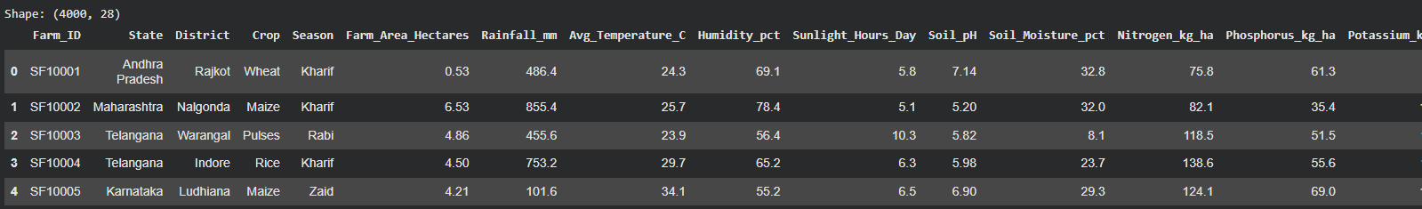
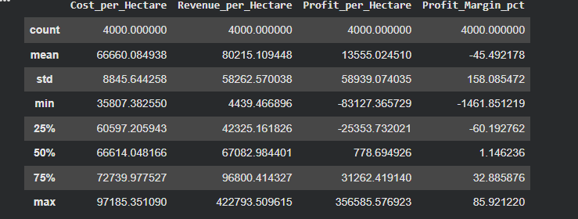
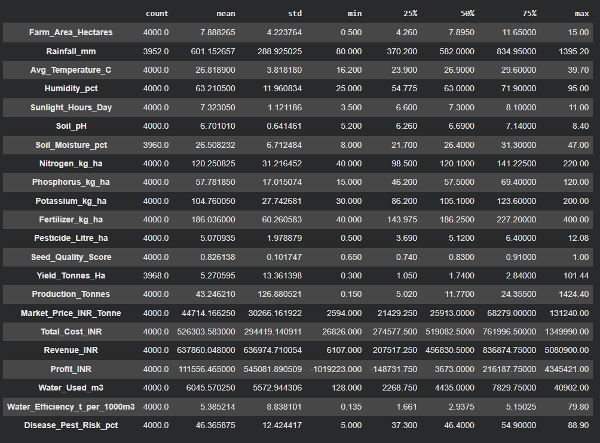
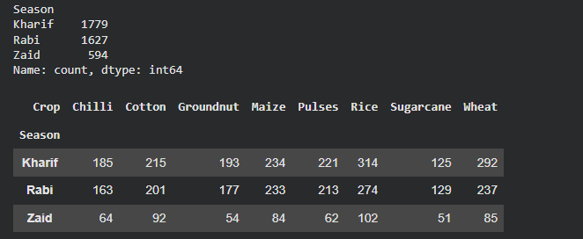
RESULTS

Slide 7
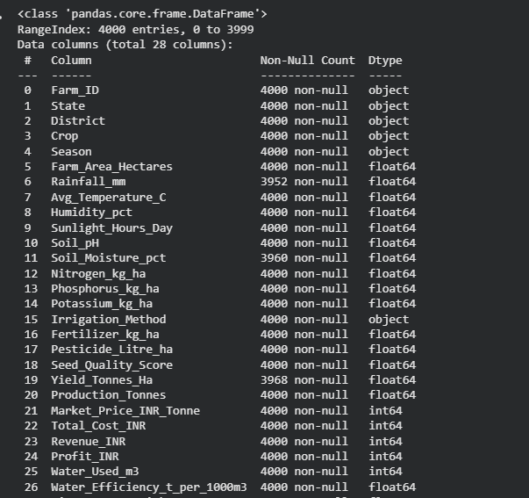
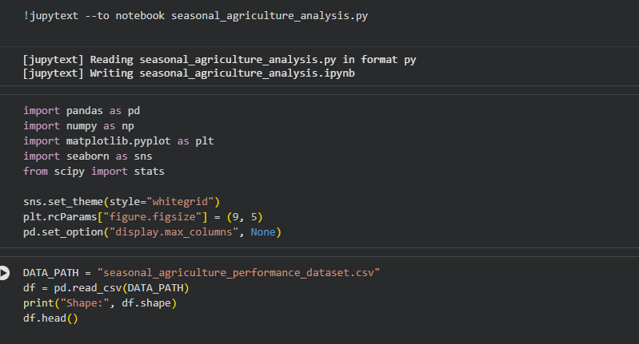
RESULTS

Slide 8
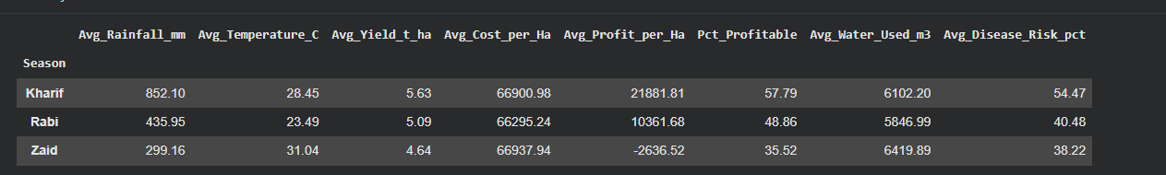
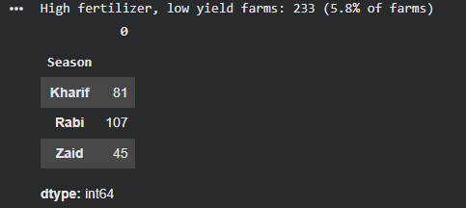

RESULTS
[Add screen shots of your code ]

Slide 9
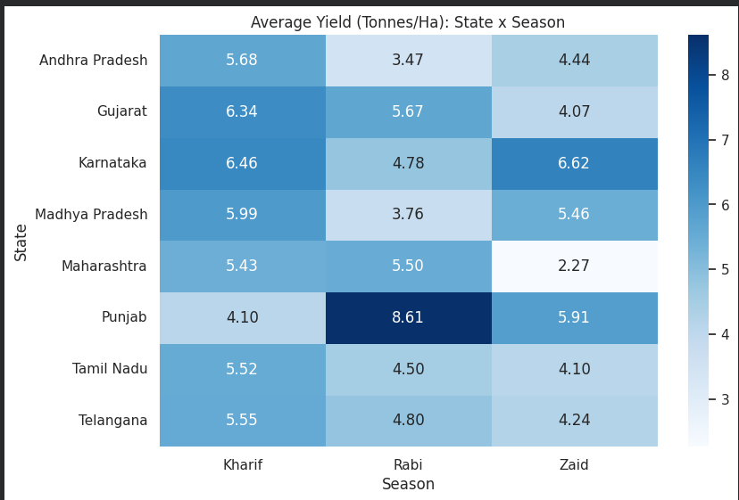
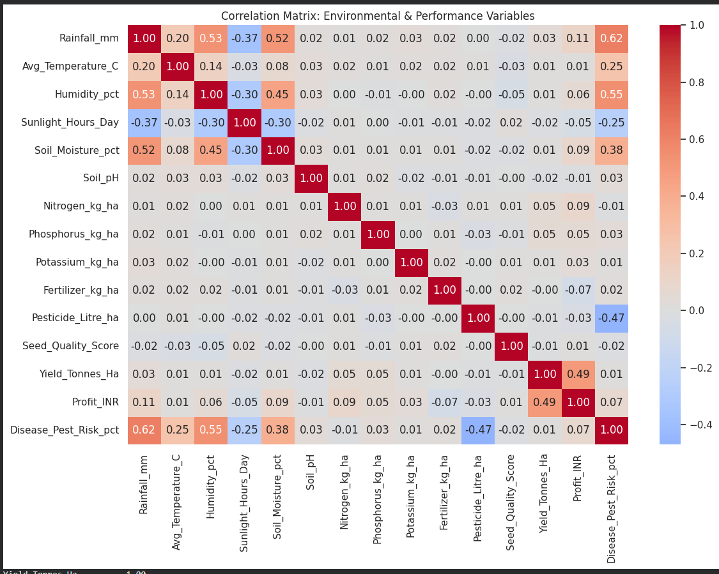
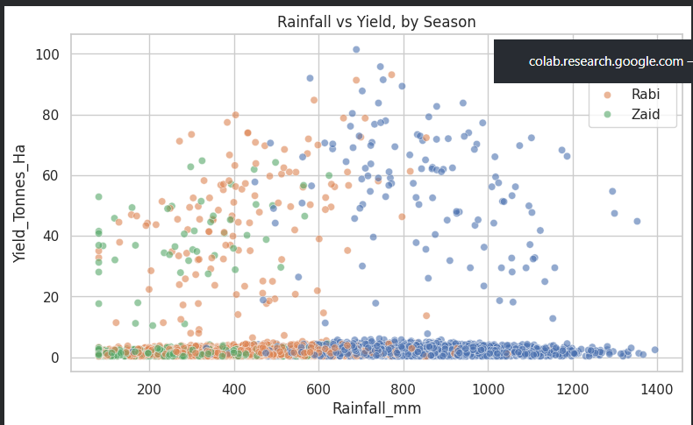
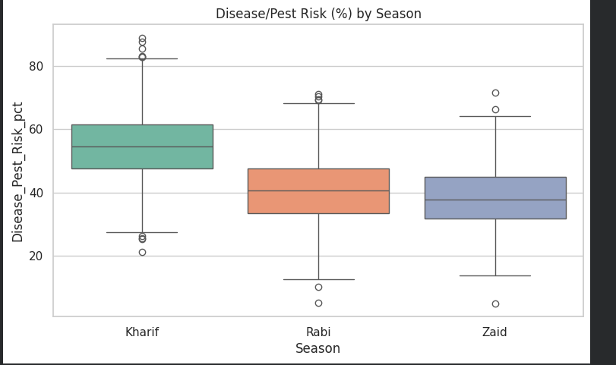
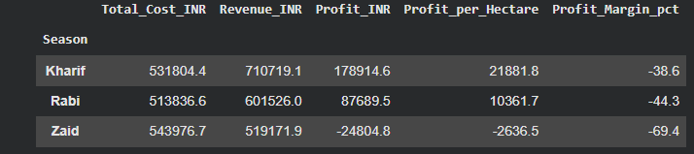
RESULTS
[Add screen shots of your code ]

Slide 10
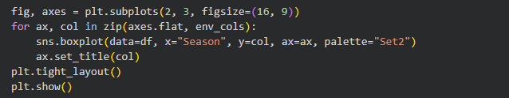
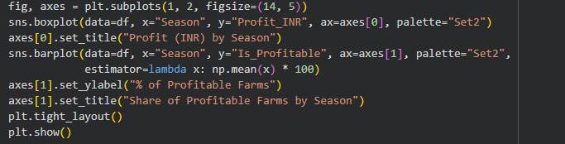
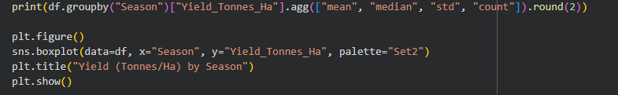
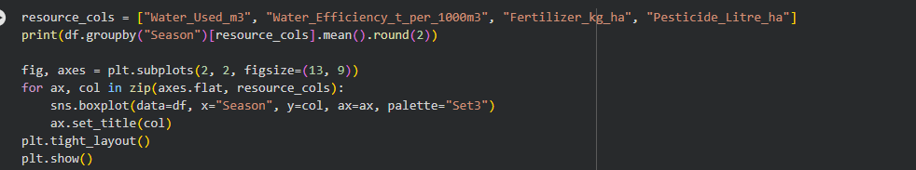
RESULTS
[Add screen shots of your code ]

Slide 11
Future scope
FUTURE SCOPE
1. Build a predictive model (e.g. regression) to forecast yield and profit for a given season, crop, and soil condition.
2. Extend the dataset to more states and integrate real-time weather/soil data for season-ahead planning.
3. Develop an interactive dashboard for farmers and planners to explore insights without needing to run code.

Slide 12
GitHub Link
https://github.com/dhanalakshmi18806-ctrl/VOIS_seasonal_agriculture_performance_analysis.git

Slide 13

VOIS Course completion certificate -
Course name- Data Visualization

Slide 14
Thank you
.
.

